Slide 1
Find()

Slide 3
Find() syntax
db.collectionName.find();

Slide 4
Find() syntax
db.collectionName.find(
{filterConditions},
{projections}
);
Documents to include
Attributes to include

Slide 5
Find() syntax
db.collectionName.find(
{filterConditions},
{projections}
).sort({sortCondition});

Slide 6
Find() syntax
db.collectionName.find(
{filterConditions},
{projections}
).sort({sortCondition})
.limit(RowstoReturn);

Slide 7
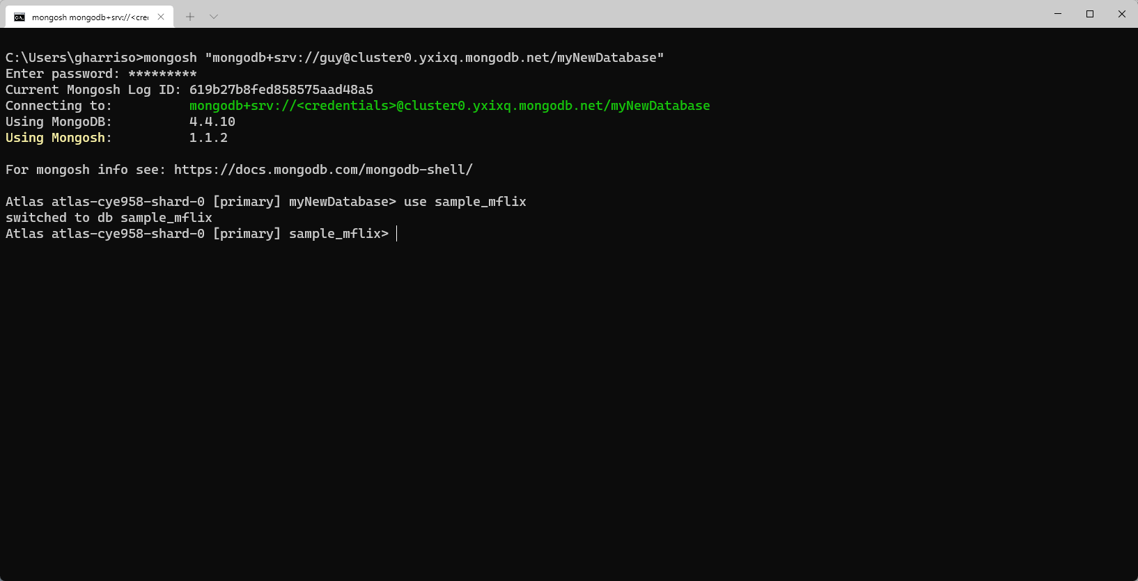

Slide 8
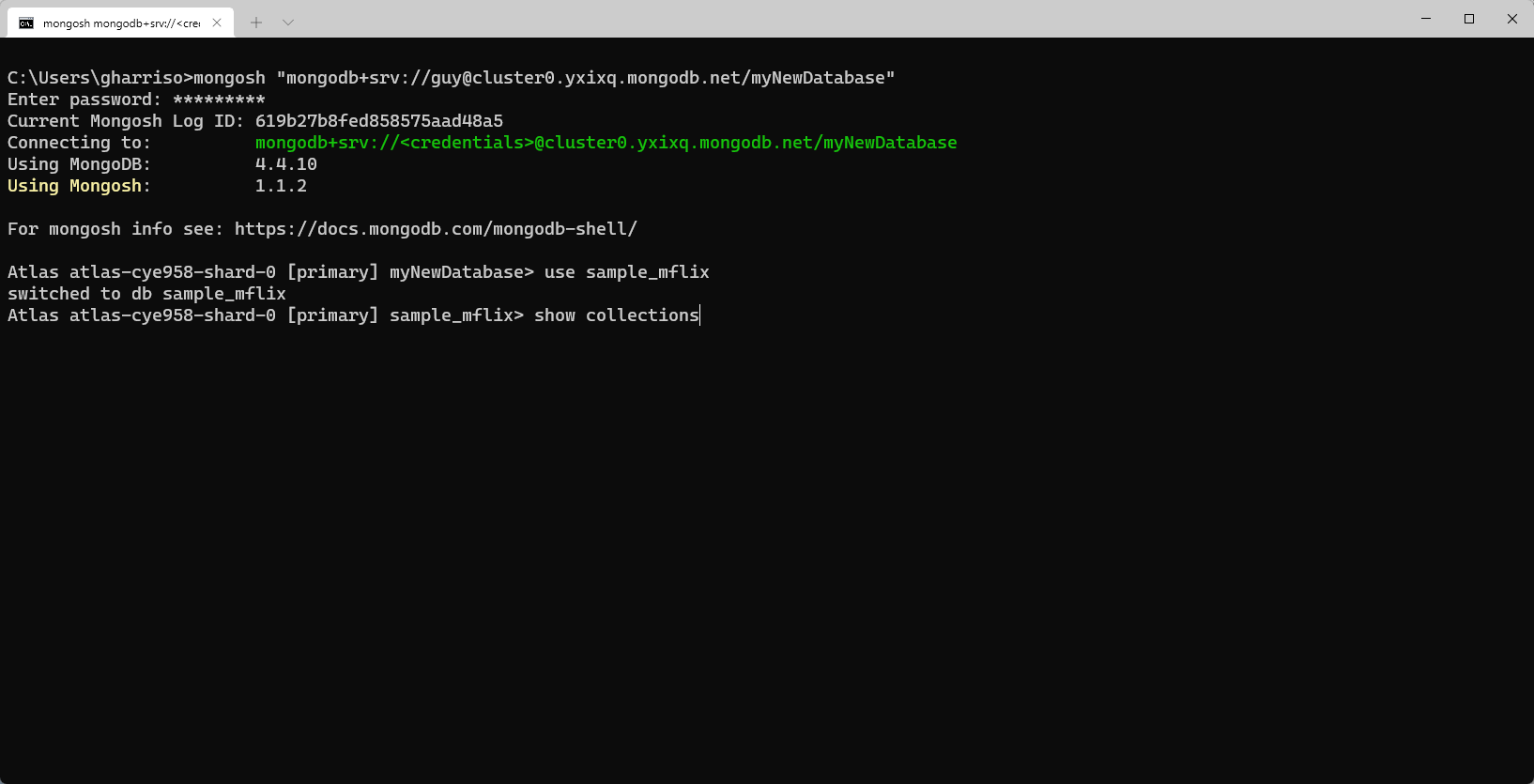

Slide 9
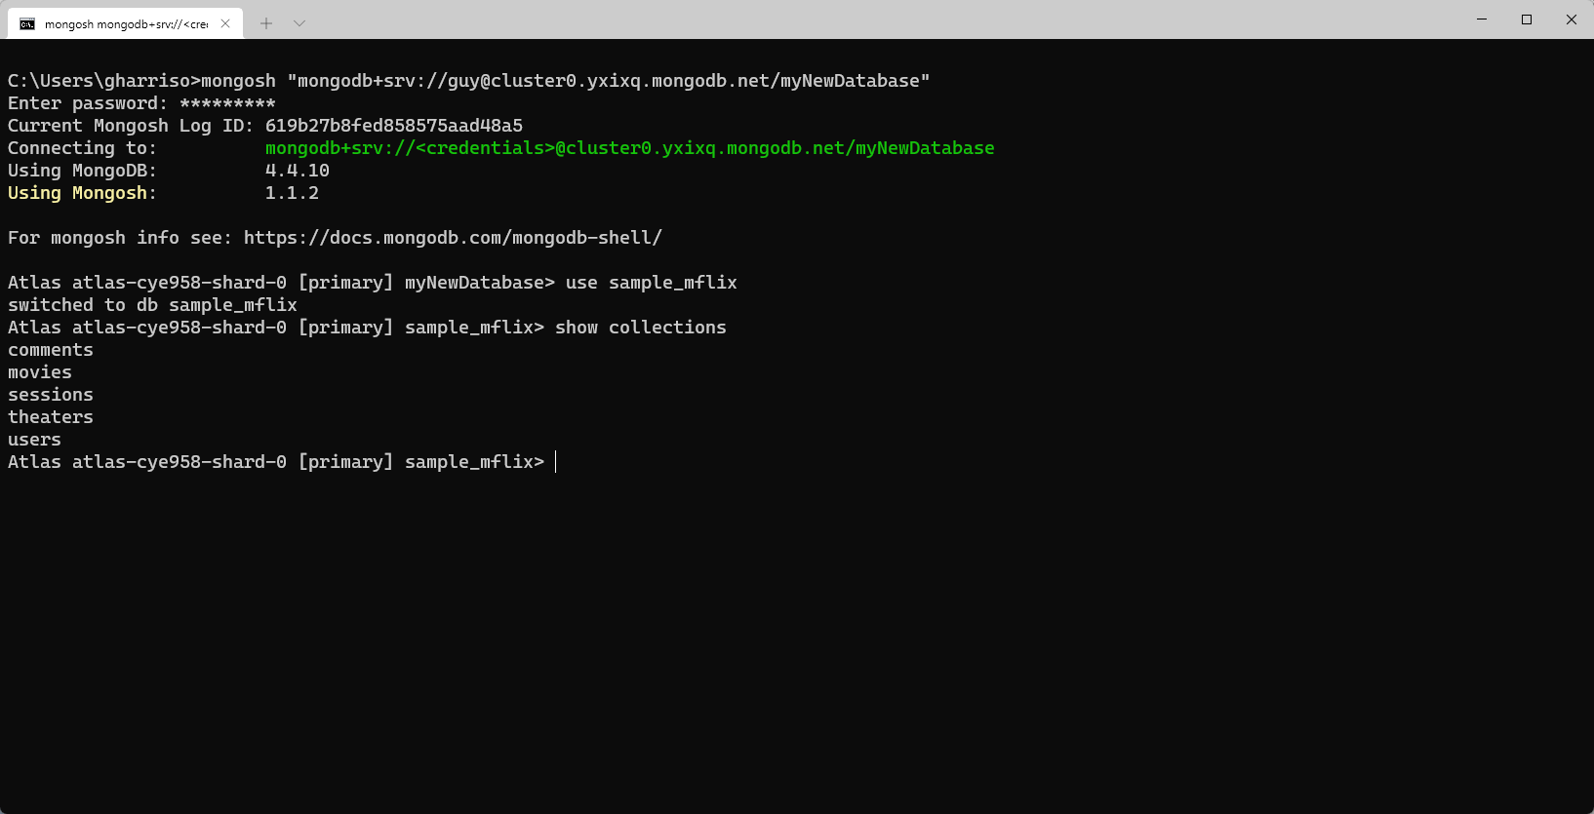

Slide 10
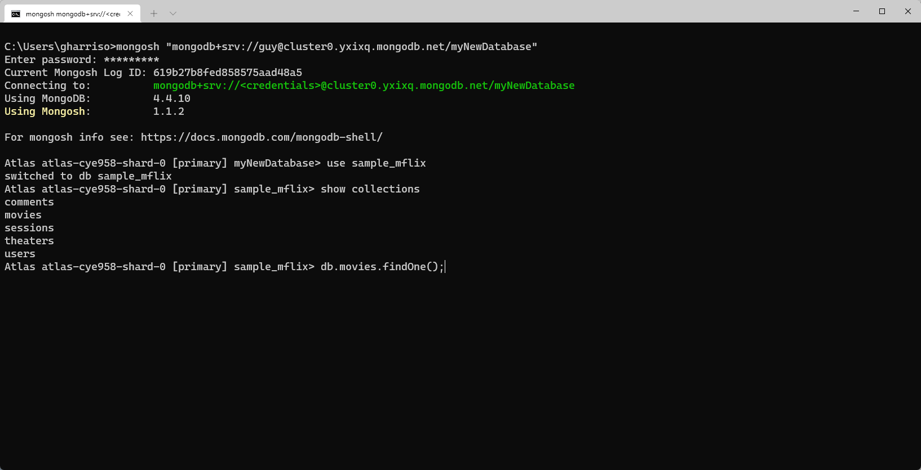

Slide 11
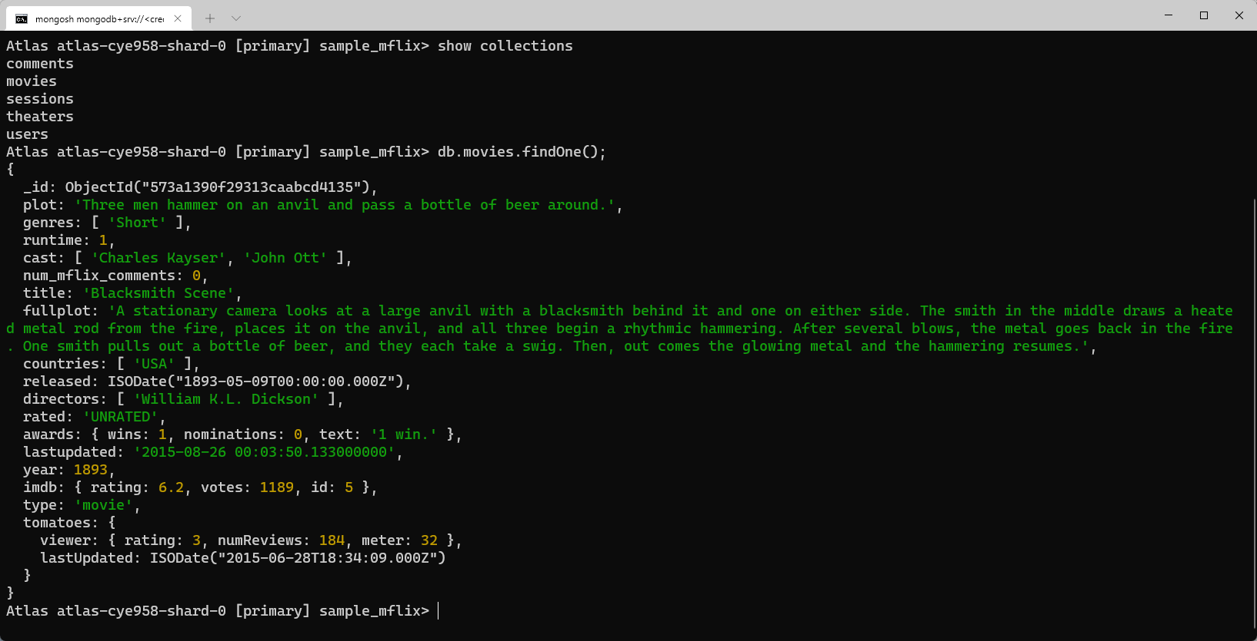

Slide 12
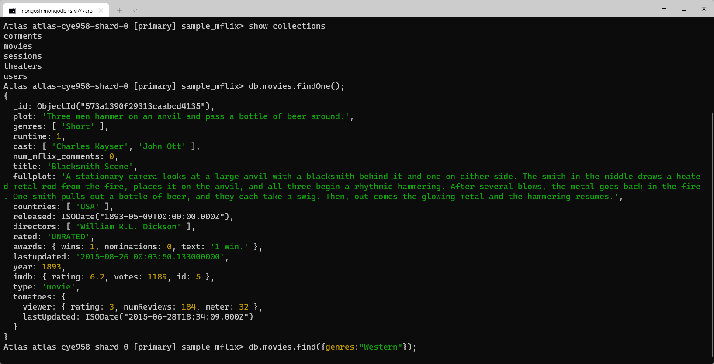

Slide 13
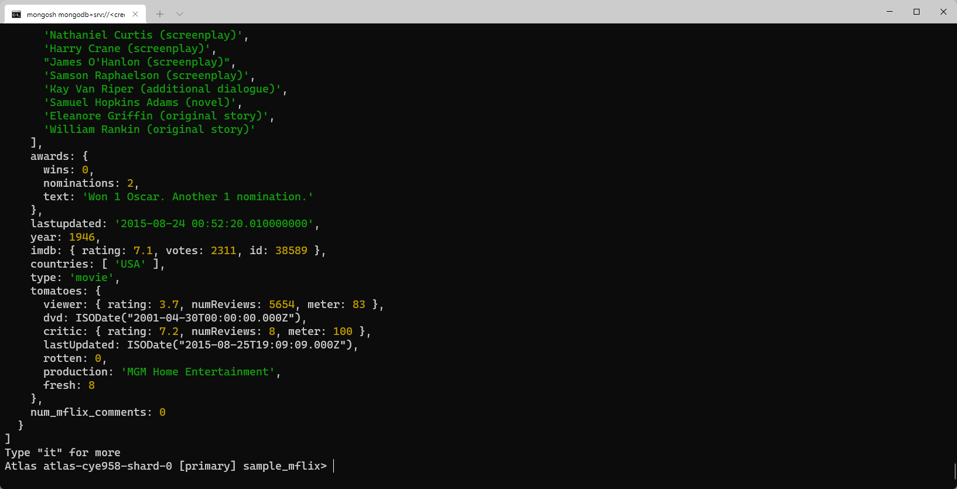

Slide 14
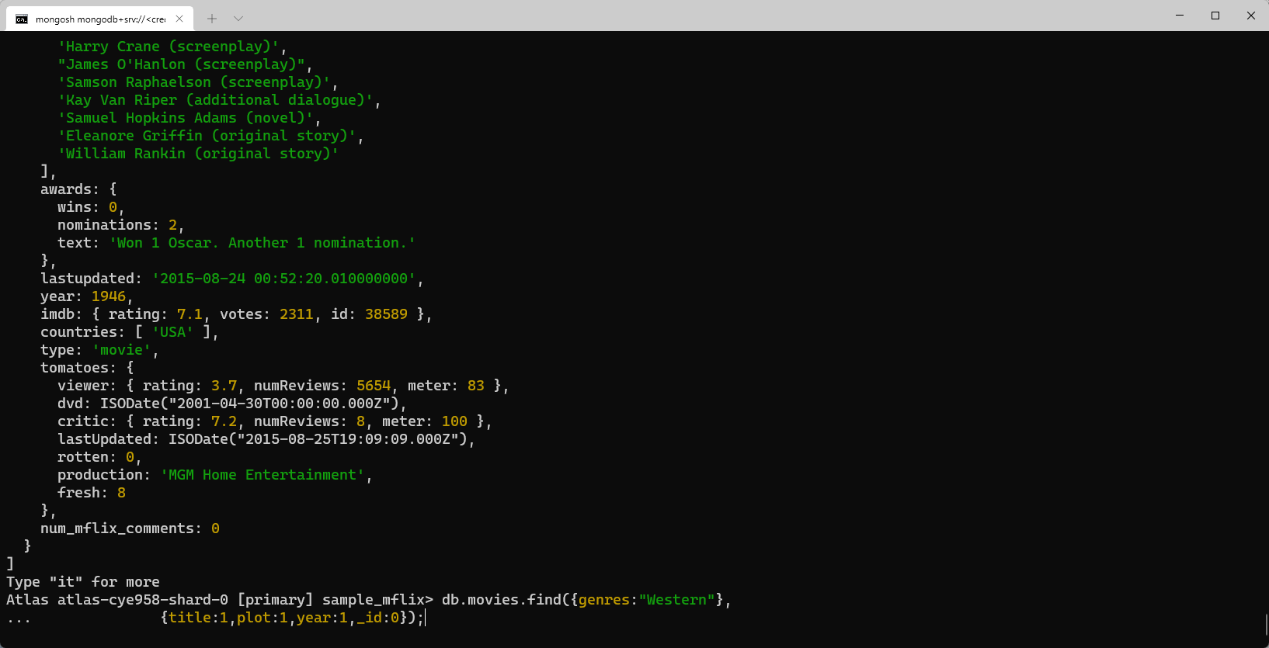

Slide 15
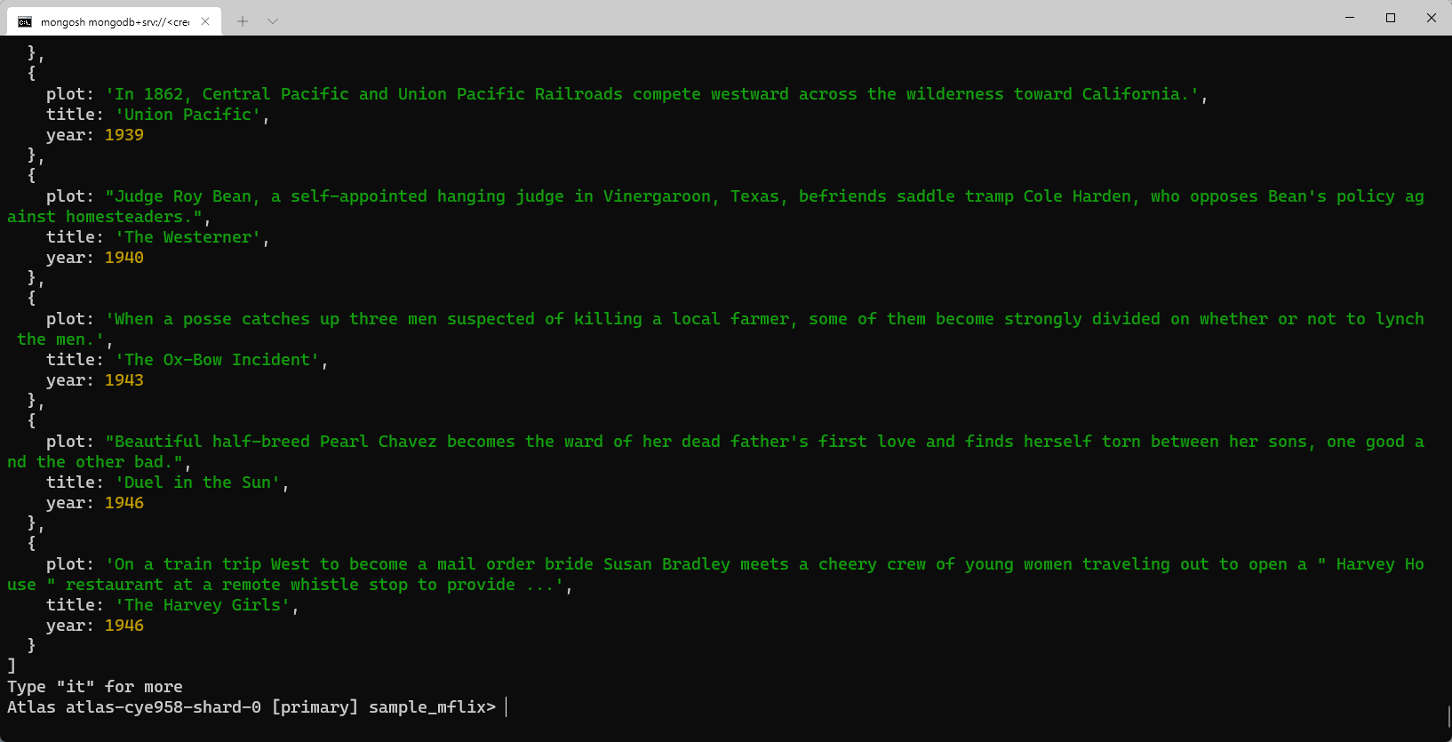

Slide 16
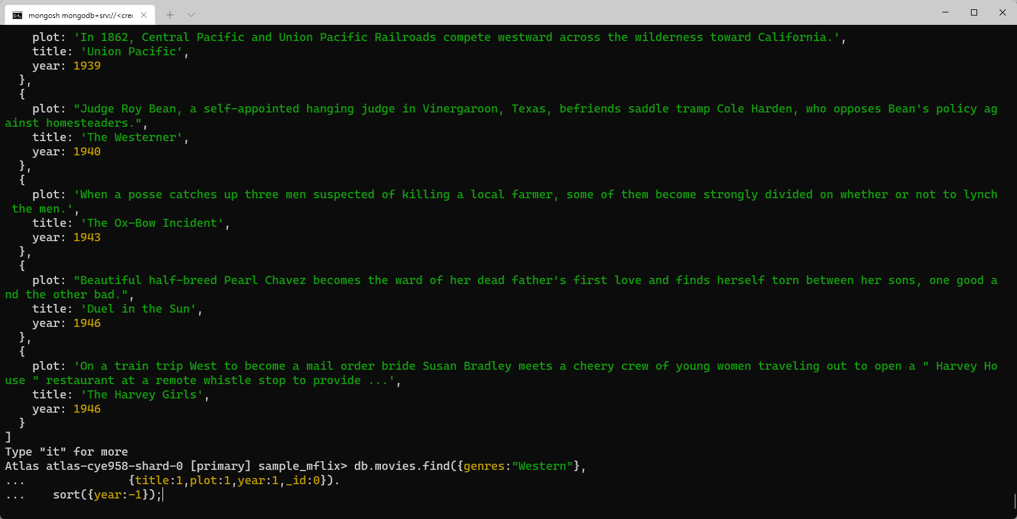

Slide 17
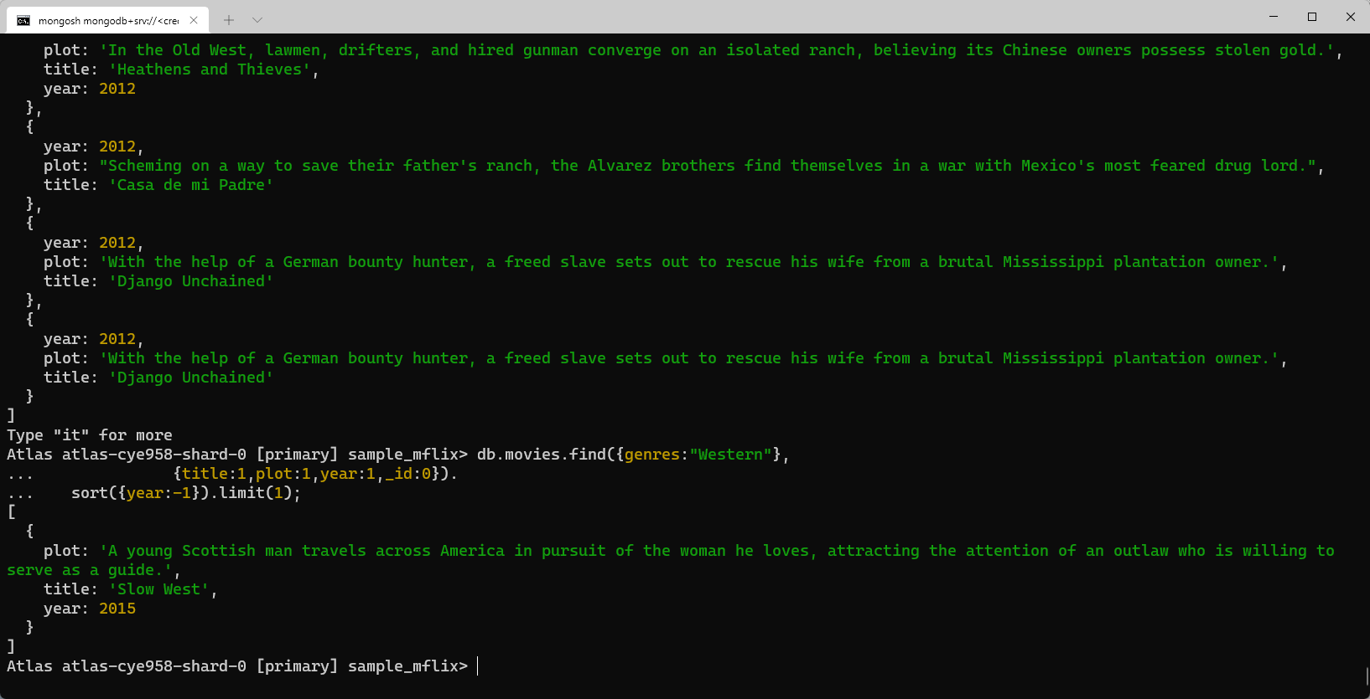

Slide 18
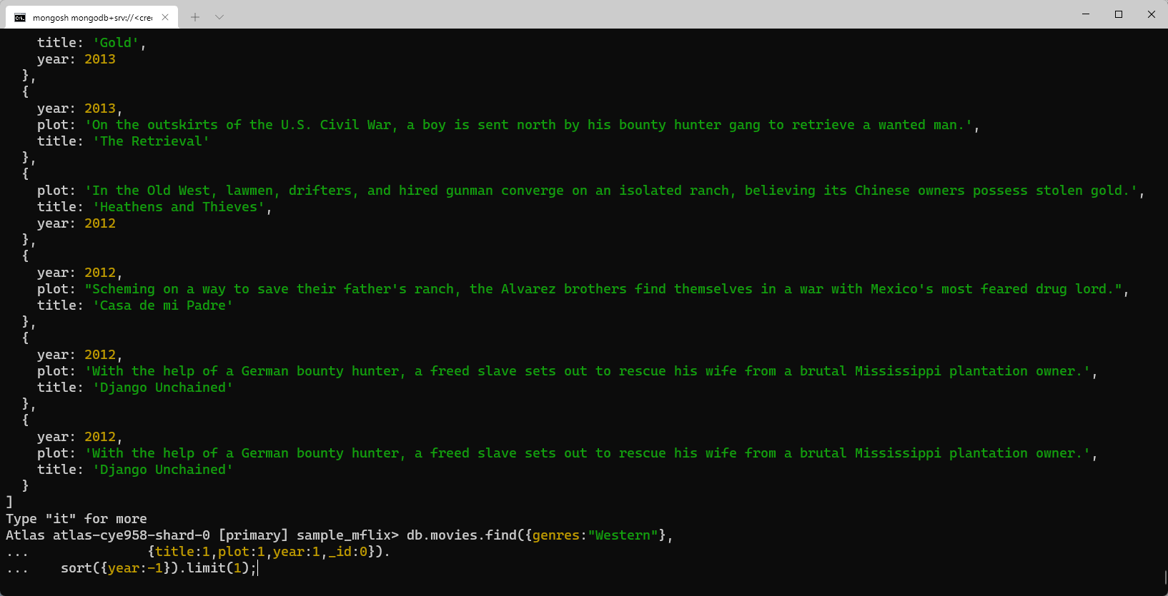

Slide 19


Slide 20
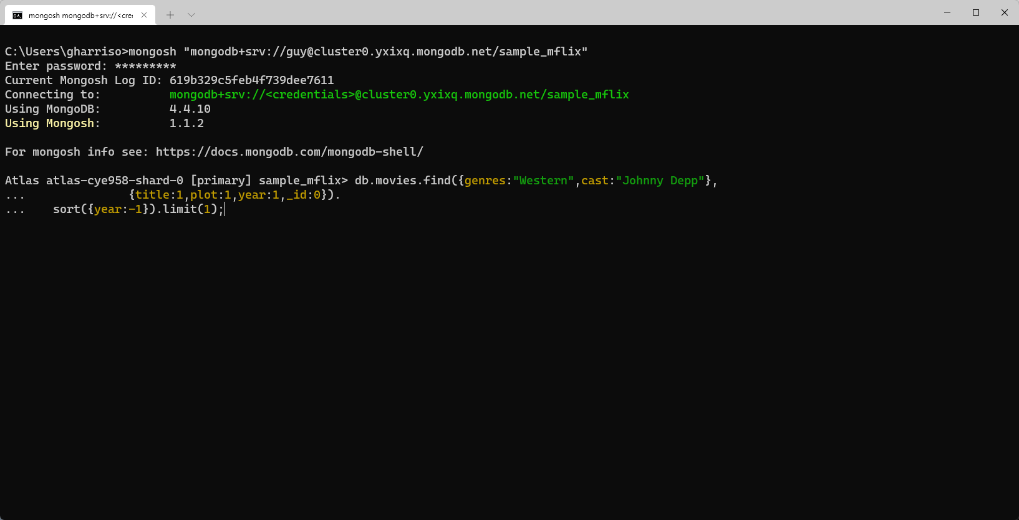
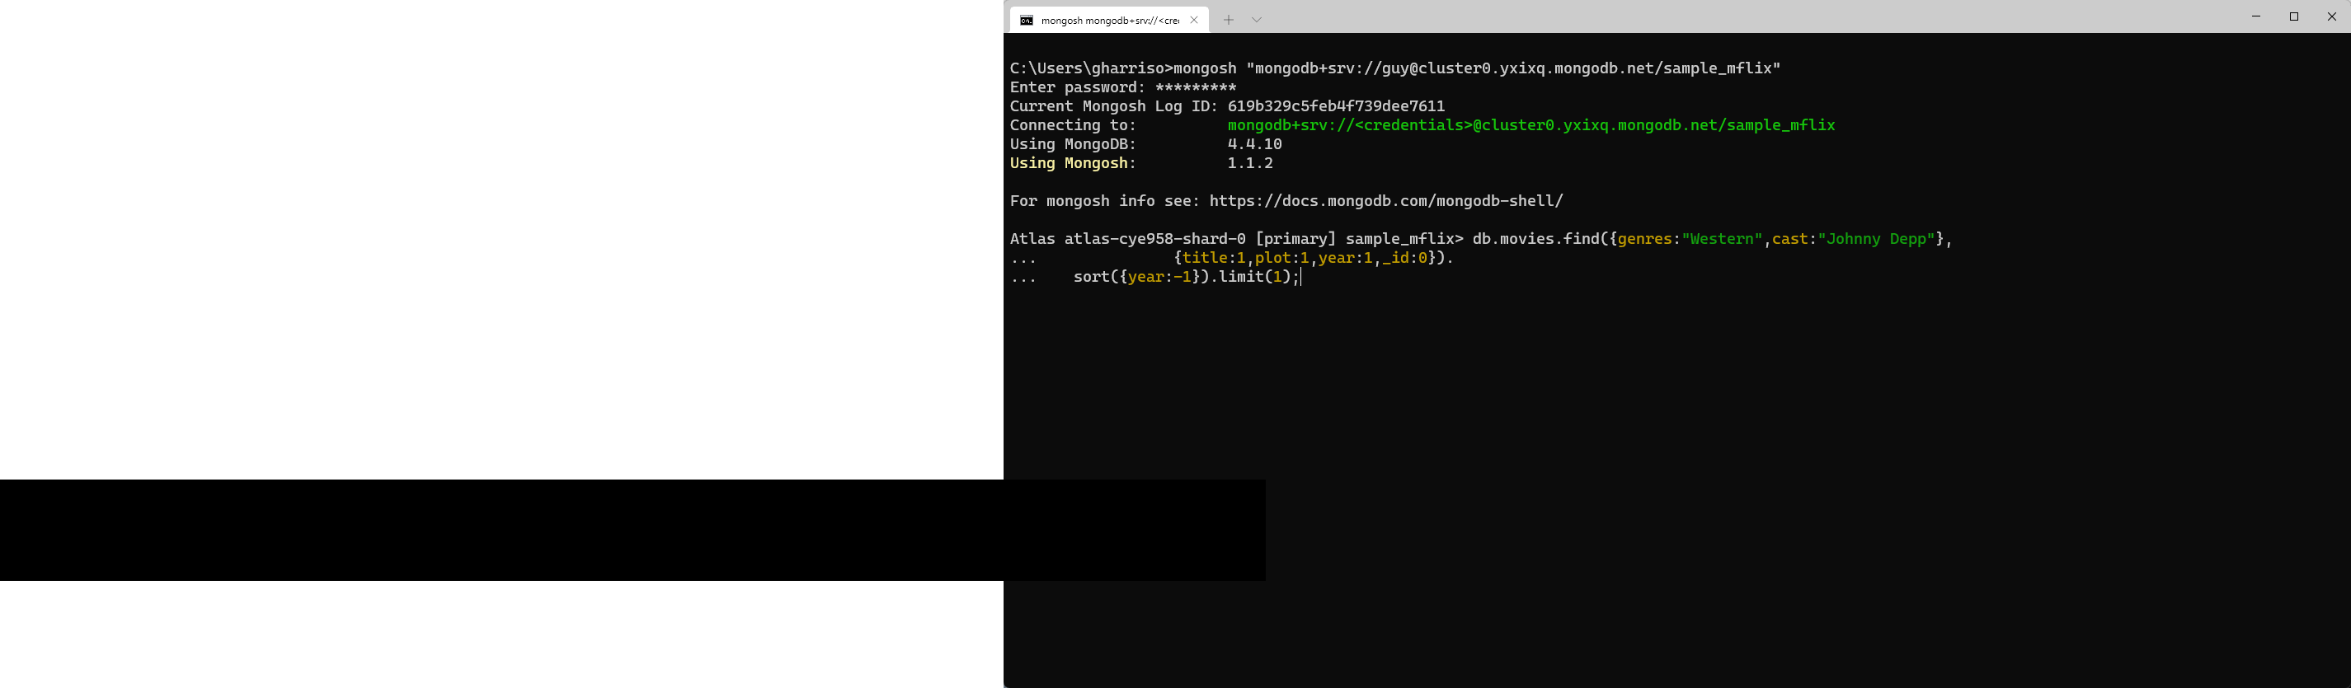

Slide 21
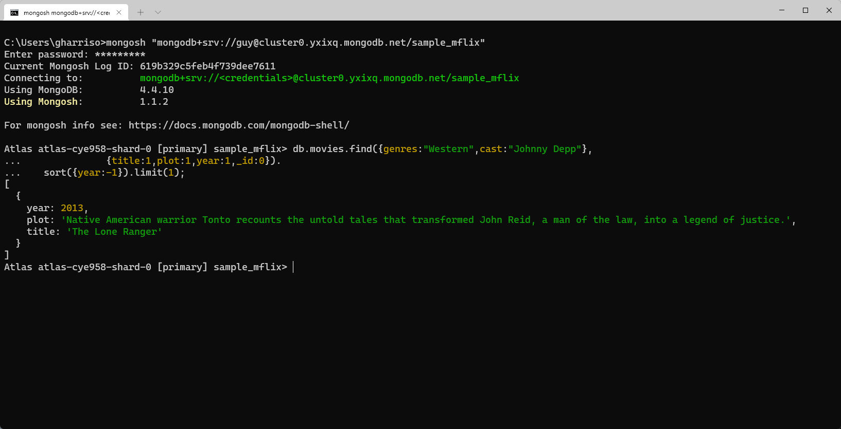

Slide 22
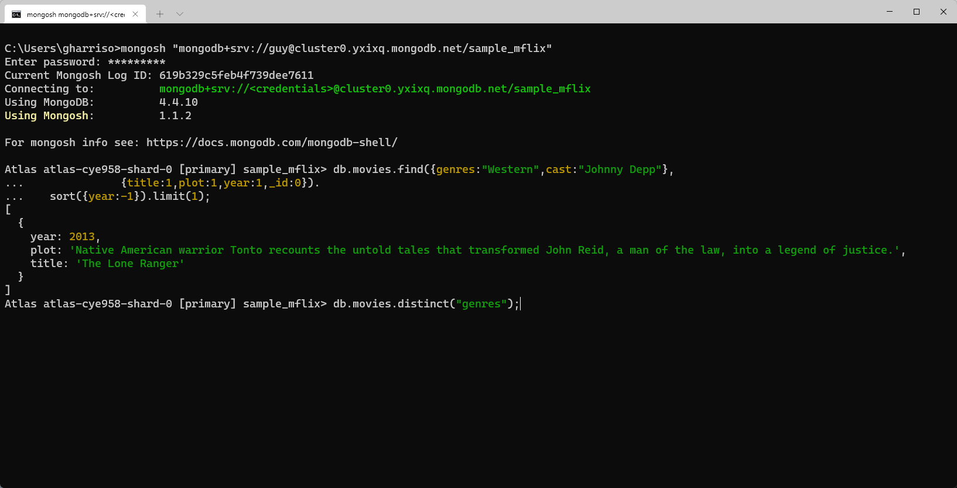

Slide 23
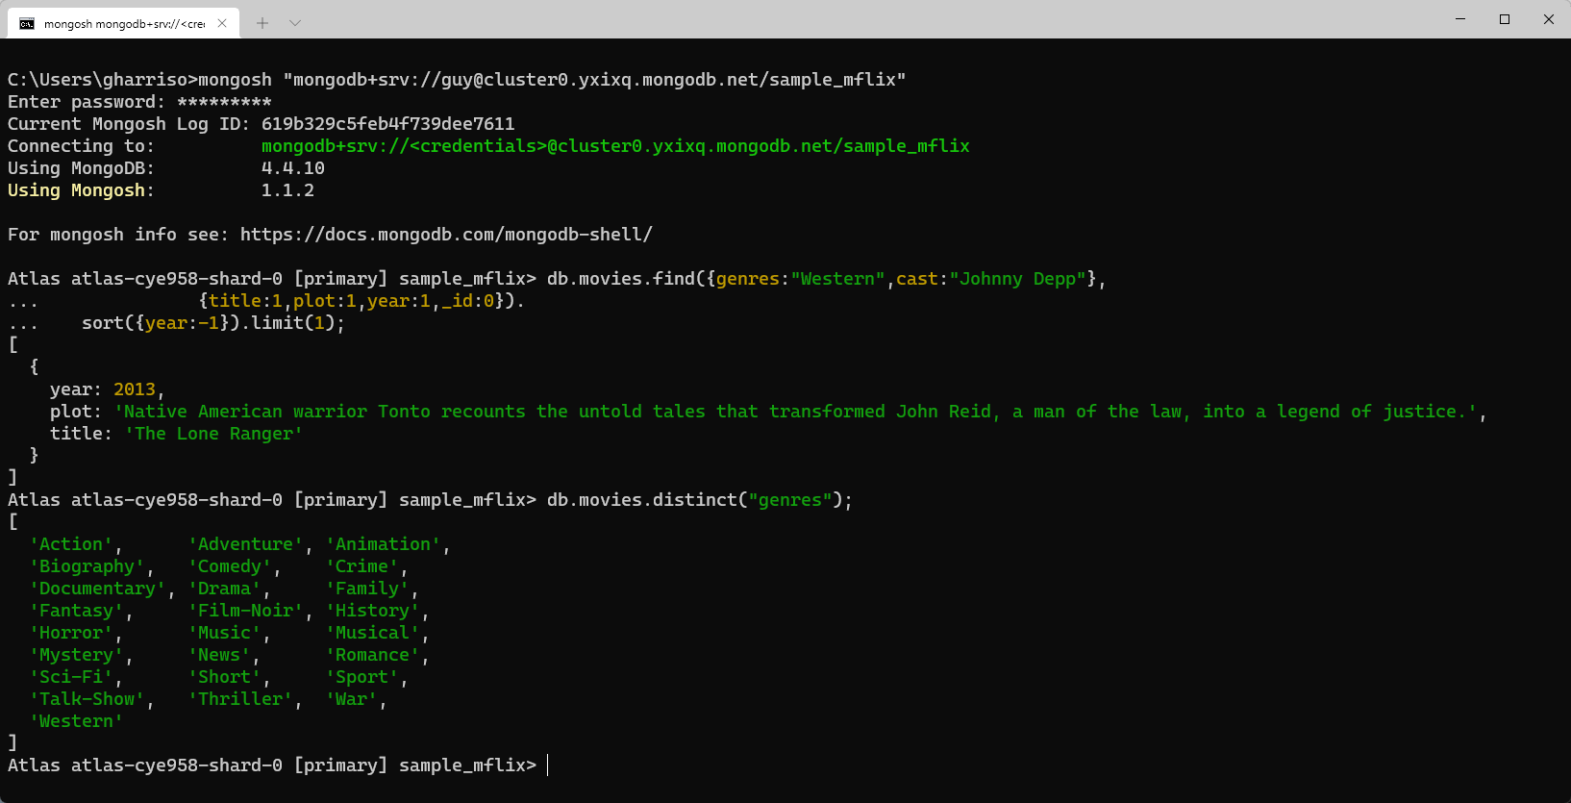

Slide 24
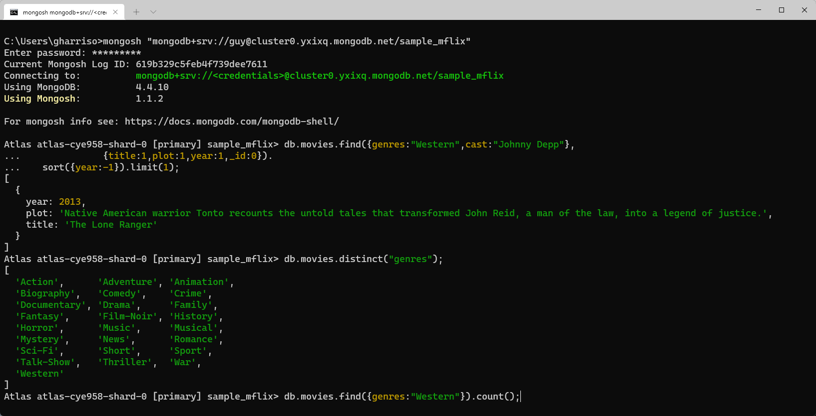

Slide 25
